Slide 1
Parallel particle swarm optimization on a graphics processing unit with application to trajectory optimization
Harri Renney

Slide 2
Academic Goals[1]
To reduce computation time of PSO by processing on GPU.
Develop 3 implementations to compare.
Run tests on 4 generic algorithms + 1 practical example.
Compare performance between implementations.
Investigate how controllable parameters effect performance.
Notes:
Reduce computational time of particle swarm optimization by accelerating the process on a GPU.
Develop three different implementations. Serial CPU, Partial GPU, Full GPU.
Run tests for a few generic algorithms + one practical example.
Compare speed-up achieved by GPU acceleration.
Analyze the factors that impact speed-up.

Slide 3
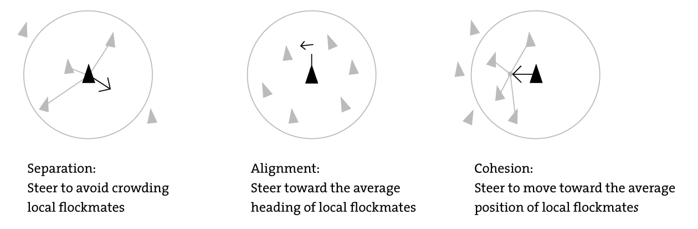
Particle Swarm Optimization
Particle Swarm Optimization (PSO) is an AI algorithm inspired by bird flocking.
Optimization algorithm. Concerned with finding a sufficiently optimal value.
Each particle acts like individual agent.
First implementation in "Boids" [2] application.
http://coffeepoweredmachine.com/wp-content/uploads/2013/08/boidsThreeRules.png
Notes:
Particle Swam Optimization (PSO) is an AI optimization algorithm inspired by bird flocking behavior.
An optimization algorithm is one in which a global optimal value is unknown but would be ideal to find. However in many such problems, a very good local optimal solution is sufficient.
Each particle is thought of as to act like an independent agent. Considering information available to it to decide on the best direction to take in a search space.
A fitness function needs to be known or available as a black box to process new values generated through.
The first implementation was the "Boids" application [2]. It demonstrates the use of PSO on bird like objects which consider neighbors information to decide on how to update itself. However, it does not consider the global flock information like most PSOs would.

Slide 4
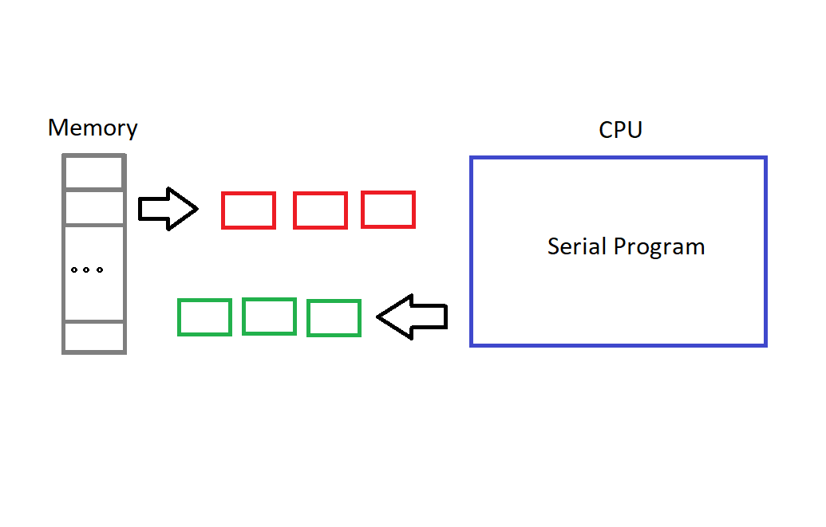
CPU Implementation– Serial Approach
Considers each item of data at a time.
Works well for many problems.
Avoids memory sharing issues.
A naïve approach to PSO.
Notes:
The CPU implementation takes the naive approach of evaluating each particle one after another, serially.
This works well or is the only possible method for many problems.
Issues arising from sharing memory are not a problem, which can cause undefined performance.

Slide 5
CPU Implementation – Possible Improvements
Issue with this is paper is comparing serial SISD approach to parallel SIMD.
Interesting, as the paper still achieves a few things.
However, it would be really interesting to compare parallel CPU to GPU.
CPU could use MIMD approach using OpenMP.
Or could use SIMD using an intrinsic library, like libsimdpp.
Notes:
Issue is that this paper is now really comparing a serial SISD approach to a parallel SIMD approach.
This is still a interesting thing to investigate, if somewhat obvious.
Still shows PSO can be mapped to SIMD architecture with a performance increase.
Interesting to compare parallel CPU with parallel GPU versions.
CPU application could apply MIMD, with something like OpenMP.
Or most interestingly a could apply SIMD on CPU, with a SIMD intrisics wrapper class like libsimdpp. Only certain CPUs will support.

Slide 6
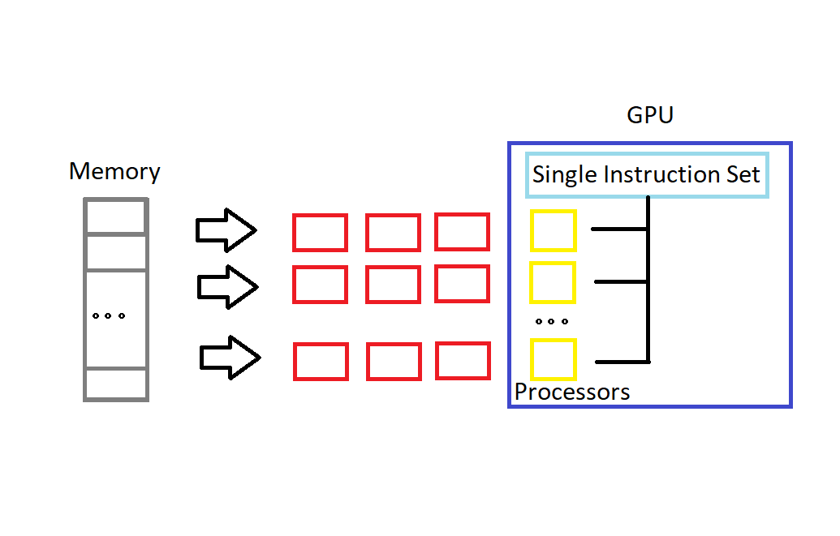
SIMD Architecture
Multiple data with same instructions applied.
Can be processed parallel across multiple compute units.
Conventional use in graphics.
Designed to scale extremely well for large inputs.
Notes:
When multiple data requires the same processing applied to it, SIMD architectures can be used.
Data can be processed in parallel across multiple compute units.
All compute units draw from the same instruction set/program which is applied to the data.
Conventional use in graphics, where millions of pixels require compute, all with the same shader program.
Expected to scale well.

Slide 7
GPU Implementation – SIMD Processing
General Purpose Graphics Programming framework CUDA used.
PSO fits SIMD architecture really well.
Each particle independent, only needs to share local/neighbours information.
Same process applied to all particles, just different input.
Notes:
The general purpose graphics programming framework CUDA is used. Restricted to Nvidea hardware.
The SIMD architecture seems to naturally fit particle swarm optimization really well.
Each particle is independent of one another, only some memory shared between neighbouring particles(
The same algorithm/instructions applied across all different particles, each a different piece of data.
Just requires a barrier/wait at end for all parallel processing to finish before starting the next iteration.

Slide 8
Possible alternatives to CUDA
Another interesting method would be to use an alternative to CUDA.
OpenCL is an obvious alternative.
A true graphics API, like OpenGL. Could be done by mapping PSO into graphical concepts.
This could work by using colour channels of fragments to hold particle information.
Position
Direction
Speed
Notes:
I would suggest another interesting area to investigate would be in the methods of programming the GPU.
OpenCL is an obvious alternative to CUDA. Another GPGPU framework, with argueably better features and performance.
Another could be to use a true graphics API, like OpenGL. Then making PSO into graphical concepts, processed through the graphics pipeline, then results output to a custom framebuffer rather than rendered to a screen.
I could see this working something like having a texture of particles. Particles can access neighbouring particles data. An algorithm defined in shader applied to each fragement/particle. Default RGBA channels can be used to hold position, direction, speed.

Slide 9
Partial and Full GPU Implementation
Partial and Full GPU implementations developed.
Partial only processes fitness calculation on GPU.
Full processes initialization, calculation and updating on GPU.
Demonstrates cost of overhead copying between CPU and GPU.
Notes:
In the paper, they develop a partial GPU implementation. This only parallelizes the fitness function calculation.
In the full GPU implementation, the initialization, fitness and updating are all parallelized on the GPU.
Demonstrates overhead of CPU, GPU communication and why best to avoid.

Slide 10
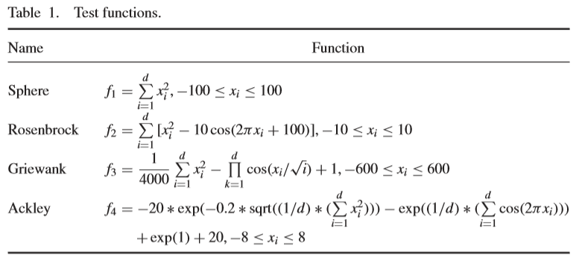
Methods Tested
4 different algorithm where run with the implementations and analysed.
The algorithms are used to verify results. The algorithms have different levels of complexity.
Sphere, Rosenbrock, Griewank, Ackley.
Notes:
4 different algorithm where run with the implementations and analysed.
The algorithms are used to verify results. The algorithms have different levels of complexity.
Sphere, Rosenbrock, Griewank, Ackley.

Slide 11
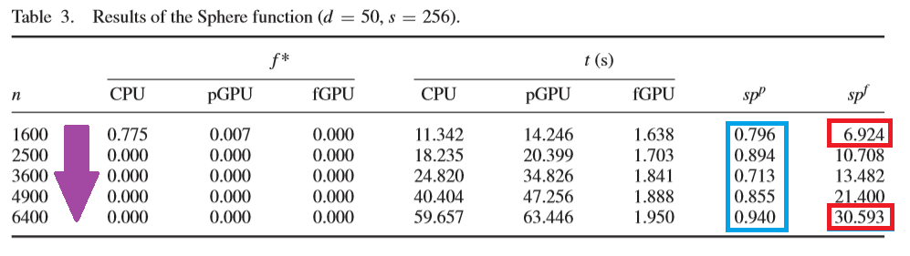
Single Factor Analysis
Single parameter, the number of particles changed.
Speed-up increases with n.
Speed-up increase does reduce slightly. N exceeds GPU threads.
Speed-up not achieved at expense of accuracy.
Notes:
A constant set of parameters kept constant.
Single control parameter number of particles(n) is changed and results compared.
The speed-up of the GPU implemntations increases with n, this is expected as each new n is just computed in paralle rather than serial where it would have to wait.
However as n increases past thread count possible on GPU, the speed-up increase begins to reduce.
Full GPU implementation is always greater than the partial one. And is only a small amount better than CPU, and in some cases worse. This is likely because of the overhead copying data between CPU and GPU. Not necessarily because those other parts of parallelism, though this does increase performance.
Optimal solutions of all implementations very similar. Therefore speed-up gained is not achieved at the expense of accuracy.

Slide 12
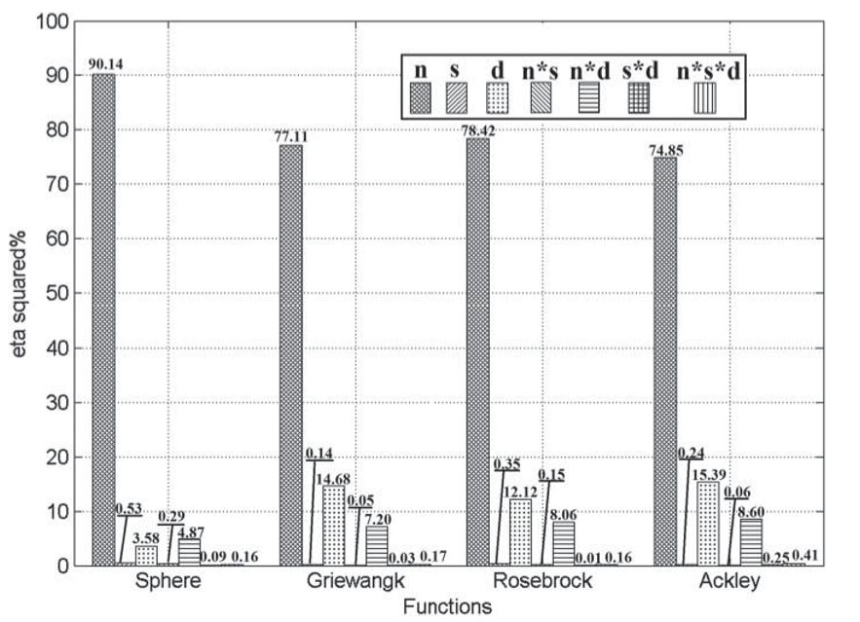
Multiple Factor Analysis
Control factors are:
N = Number of particles
D = Solution dimensions
S = Thread block-size
Notes:
Control factors are: Number of particles (n), dimension (d), thread block-size (s)
Idea here is to changed each parameter in combination and analyse effects.
Particle number n has a significant impact on speed-up. This is expected.
Followed by dimensions, this is the dimensions the particles must consider in search space. This makes sense as GPU is designed to handle increasing dimensions and can parallel them well.
Followed by combination of particles and dimensions.
Block size and all combinations with it have very little effect on speed-up.

Slide 13
Trajectory Analysis
Trajectory analysis for aircrafts. PSO used as an alternative to direct numerical methods.
Particle count of 10,000! Demonstrates effectiveness of parallel processing.
Full GPU in 9s
Partial GPU in 20s
CPU in 1464s
Therefore a speed-up of 161x by GPU.
Notes:
Trajectory analysis in aircrafts is a real world example of a problem which PSO can be used to find an optimal solution to instead of direct numerical methods.
They have used a particle count of 10,000! This is impressive and demonstrates the effectiveness of parallelize which a serial implementation cannot handle well.
And apparently all methods arrive at almost the same optimal solution. However, the full GPU implementation does it in 9s, the partial in 20s and the CPU in 1464s.
All implementations arrive at same optimal solution.
Full GPU in 9s, partial in 20s and CPU in 1464s.
Therefore speed up of 161!
This just really demonstrates tackling this kind of problem serially is just not suited at all.

Slide 14
Conclusion
PSO fits SIMD architecture naturally.
Factors that effect performance analysed.
Comparison between parallel and serial approach to PSO.
Partial GPU shows copying overhead.
Reinforces GPGPU programming is powerful and available.
Future parallel CPU version worth investigating
Notes:
A lot of interesting future areas closely related which are worth investigating. Especially in performance analysis.
Good to analyze how different control parameters effect the effectiveness of PSO in different implementation.
Good to display partial GPU implantations and overhead involved.
Show how GPU scales well to increasing input.
Show PSO is a natural problem to fit the SIMD architecture.
Show that GPGPU is powerful and ready to use for general purpose problems.

Slide 15
References
[1]: Wu, Q., Xiong, F., Wang, F. and Xiong, Y., 2016. Parallel particle swarm optimization on a graphics processing unit with application to trajectory optimization. Engineering Optimization, 48(10), pp.1679-1692.
[2]: Reynolds, C.W., 1987, August. Flocks, herds and schools: A distributed behavioral model. In ACM SIGGRAPH computer graphics (Vol. 21, No. 4, pp. 25-34). ACM.

